Slide 1
Capstone Project -1 Play Store App Review Analysis

Slide 2
Contents
Introduction
Objective
Problem statement
Description of data
Cleaning the data
Data analysis and visualizations
conclusions

Slide 3
Introduction
Google paly was launched on march 6,2012, bringing together android marking a shift in googles digital distribution strategy
There are more than 5 million apps found on google play store.
Android is the most popular operating system in the world, with over 3 billion active users spanning over 190 countries.
Lots of designs and developers work on it to make an app successful on the play store

Slide 4
Objectives
To understand consumer behaviour and demand, how they are reacts to different categories of genre of google play store apps
Find the most popular and trending apps in recent times
Find how small changes or update impacts on app performance
Analyse the reviews, rating sentiments of people towards various apps in play store
Above all, help developers or clients to recognize the gap, make the app better and meet customer expectations

Slide 5
Problem statement
Installs per Category Pricing vs Category Number of Reviews per Category
What are the top 20 apps present in the google play store as per their Genres?
Which are the Genres that are getting installed the most in top 20 Genres?
What are the count of applications in each category differentiated by their type?
How many apps were installed according to its type?
Distribution of sentiment subjectivity
Overall percentage of review sentiment
What is the most dominant category

Slide 6
Description of data
There are two types of data sets : play store data and user data
play store data:
App – name of the application
Category- category of the application
Rating – rating given to the application
Reviews – no of reviews given to the application
Size – size of the application
Install – no of downloads of the application
Type – free or paid
Price – price of the application if it is paid

Slide 7
Cont……
Content rating – it is age appropriate or not
Genres – type of genres the application belongs to
Last updated – when the last time the application is updated
Current ver – current ver of the application
Android ver – minimum android ver required to run the application

Slide 8
2. User reviews data:
App- an app name
Translated reviews – reviews being given by consumers
Sentiment – sentiment given to app by users
Sentiment polarity – polarity of sentiments measures how negative or positive the context is.
Sentiment subjectivity –the subjectivity of sentiment is how likely that sentiment is to be based on data or factual information, versus personal opinion or public notions

Slide 9
Cleaning the data
Data cleaning not just means removing the incorrect data or erroneous data. Many times we get the data which has all kinds of values some of them will cause problem during the analysis of the data and make our predictions incorrect. So we have to make sure our data has no erroneous values
data cleaning step:
Removing unwanted values
Handling missing values
Handling structural errors
Filtering unwanted outliers
Replacing missing values

Slide 10
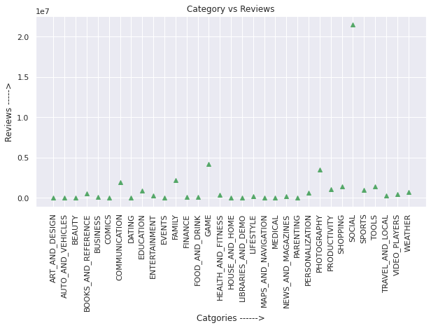
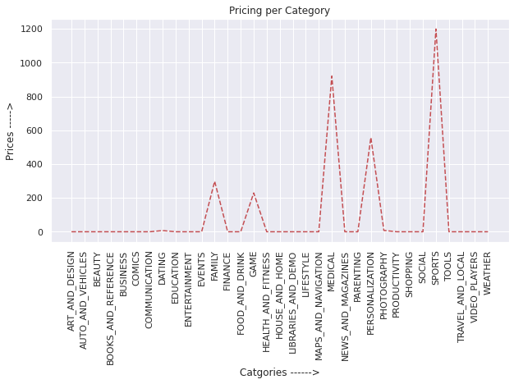
Data analysis and visualizations
1. Installs per Category Pricing vs Category Number of Reviews per Category

Slide 11
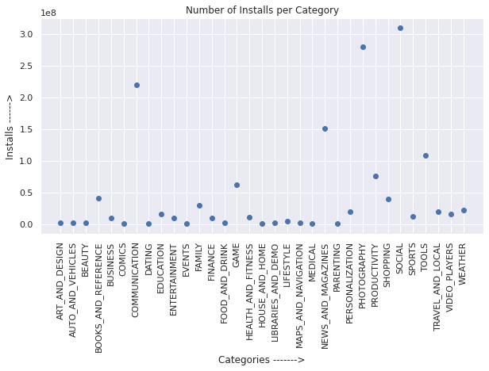
Number of Installs per Category
As we can see from the above plots: Maximum number of apps present in google play store comes under Tools, social, and tools Genres but as per the installation and requirement in the market plot, scenario is not the same. Maximum installed apps comes under social and Pathography Genres. And also maximum number of reviews comes underpin social genres

Slide 12
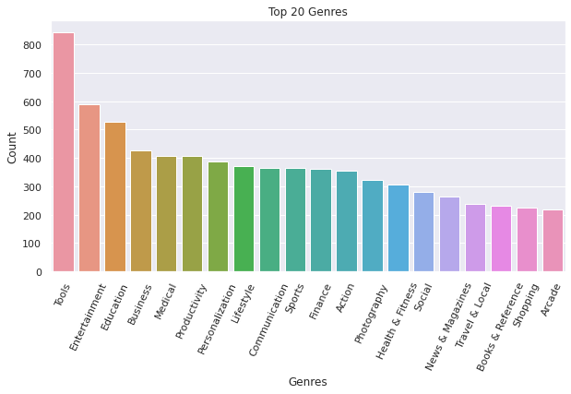
2.What are the top 20 apps present in the google play store as per their Genres?
As we can see from the above plots: Maximum number of apps present in google play store comes under Tools, Entertainment and Education Genres but as per the installation and requirement in the market plot, scenario is not the same. Maximum installed apps comes under Communication, Tools and Productivity Genres.

Slide 13
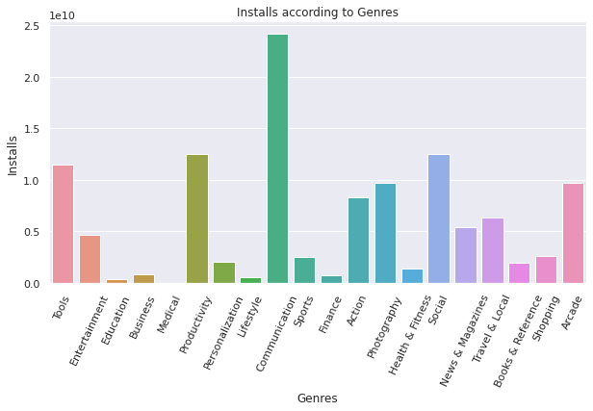
3.Which are the Genres that are getting installed the most in top 20 Genres?
As we can see from the above two plots: Maximum number of apps present in google play store comes under Communication, Social, Productivity and Tools, Genres but as per the installation and requirement in the market plot, scenario is not the same. Maximum installed apps comes under Communication, Tools and Productivity Genres

Slide 14
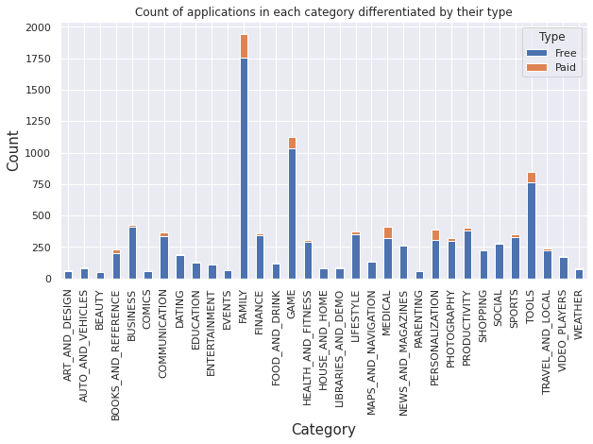
4. What are the count of applications in each category differentiated by their type?
It looks like certain app categories have more free apps available for download than others. In our dataset, the majority of apps in Family, Games and Tools categories were free to install. At the same time Family, Tools and Medical categories had the biggest number of paid apps available for download.

Slide 15
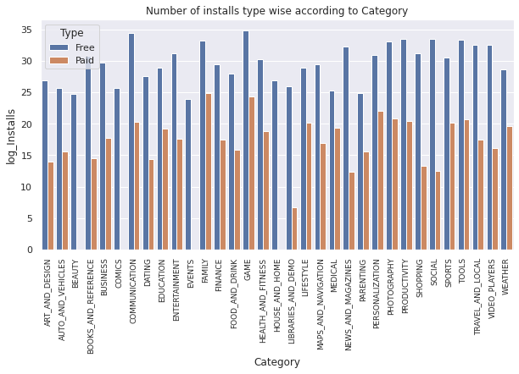
5. How many apps were installed according to its type?
It can be concluded that the number of free applications installed by the user are high when compared with the paid ones.
Size of the applications present in the dataset are in MB and KB. Therefore for ease in data processing, converting entire size column to MB

Slide 16
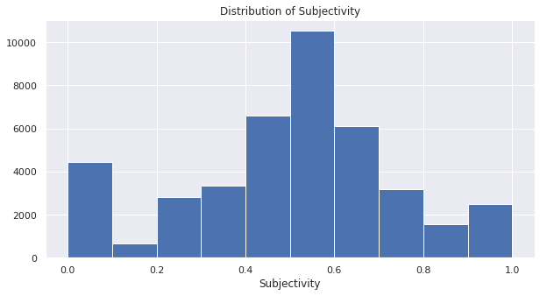
6.Distrubution of sentiment subjectivity
It can be seen that maximum number of sentiment subjectivity lies between 0.4 to 0.7. From this we can conclude that maximum number of users give reviews to the applications, according to their experience.

Slide 17
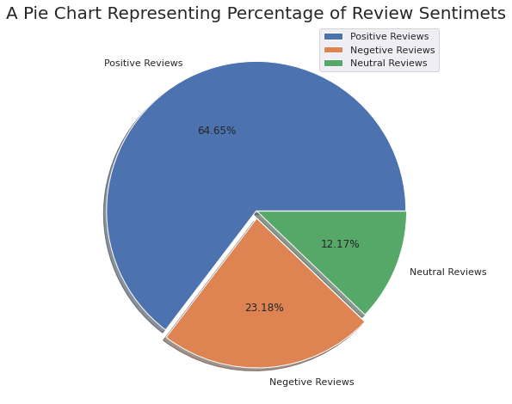
7.Overall percentage of review sentiment
Most of the sentiments reviews given by the user are positive with 64.65%
But also there is a negative sentiment percentage of 23.18%
This means app developers needs to convert more negative sentiments to neutral or positive sentiments with their hard work

Slide 18
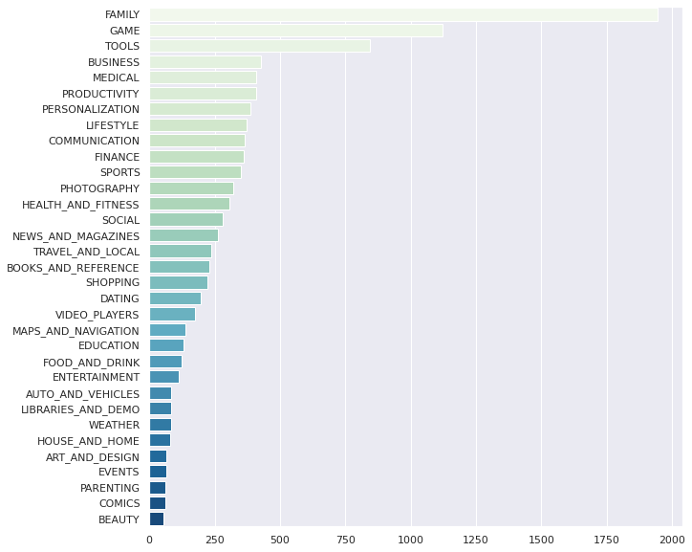
8. What is the most dominant category
This is an interesting finding, our first assumption for the most dominant category was family.

Slide 19
conclusion
Category family and genre tools are in large in numbers . But interestingly category Education and genres ‘Board: pretend play’ and ‘comics: creativity both get best average rating in play store.
App rating is directly proportional with the recent update. From this we can be sure that with the latest adaptation the reviews are giving better rating
Most of the object on sentiment subjectivity lies high in the range 0.4 to 0.7 .it means people give review after some experience.
Most of the sentiments reviews given by the user are positive with 64.65%
But also there is a negative sentiment percentage of23.18%.This means app developers needs to convert more negative sentiments to neutral or positive sentiments with their hard work.
It can be concluded that the number of free applications installed by the user are high when compared with the paid ones.
it can be concluded that Maximum installed apps comes under Communication, Tools and Productivity Genres.

Slide 20
Cont.……..
We can also found that peoples sentiment are more towards paid app and most of their sentiments are positive towards play store app. It concludes that they are happy with play store apps and 5thay except much from paid apps
Google play store apps has more free apps than paid apps and family category apps are always free. It conclude that people are not willing to pay for entertainment, education apps but for health and medical purpures people are ready to pay.

Slide 21


